Slide 1
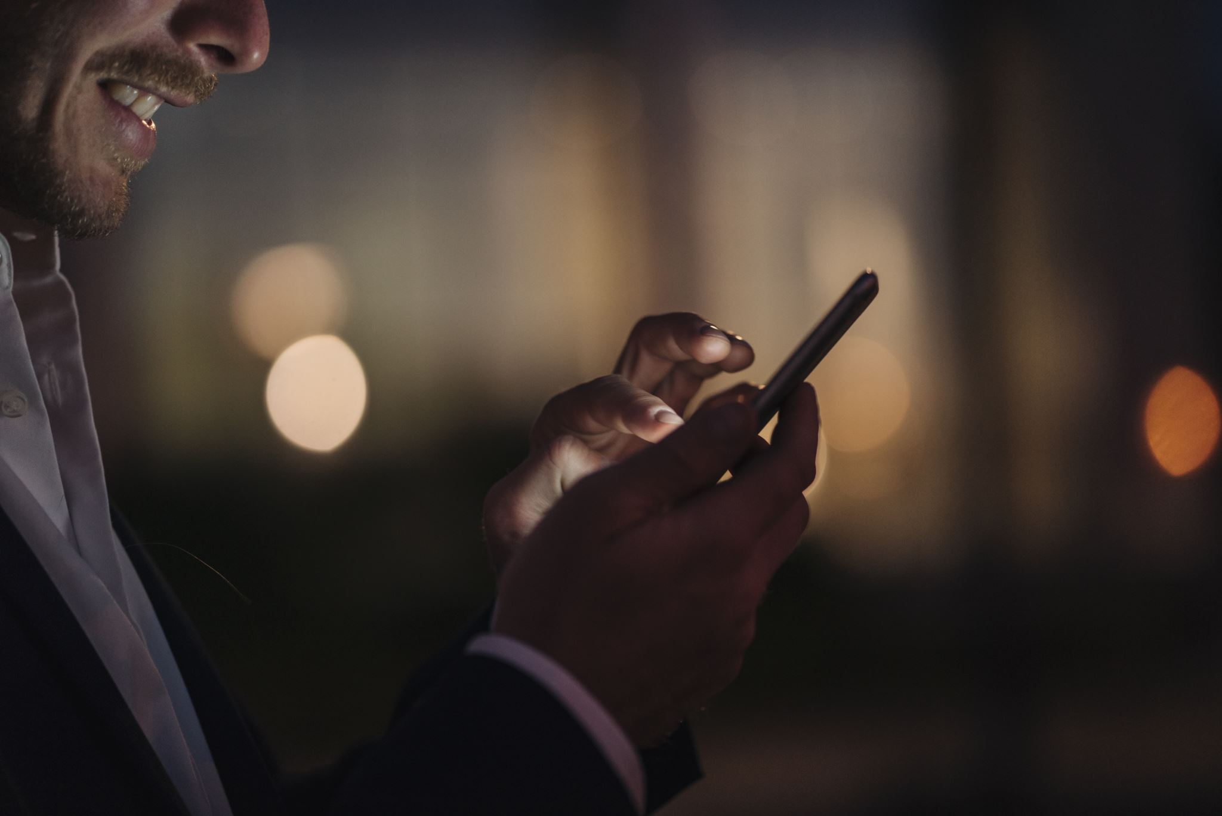
Social media
Presentation by Afifa Muneer

Slide 2
Advantages
STAY UP TO DATE
GET CONNECT TO NEW PEOPLE
TARGET AUDIENCES BASED ON THEIR INTRESTS
MAKE COMMMUNICATION EASIER

Slide 3
Disadvantages
NEGATIVE IMPACT ON MENTAL HEALTH
ADDICATION AND DISTRACTIONS
LACK OF CONFIDENCE
FAKE NEWS AND JOBS TOO
SPENDING A LOT OF TIME ON SOCIAL MEDIA
NO PRIVACY
SLEEPNESS OR INSOMNIA
TIME CONSUMING

Slide 4
THANKYOU !

